Slide 1
Using Agents to model the eBay economy
David Shepard

Slide 2
Process
Objective: Determine if a computer program can create agents to emulate the behavior of real bidders on eBay
Method: Retrieve detailed data on real eBay auctions, create agents that use this empirical data as a model
Success: Simulated auctions and eBay auctions follow a similar pattern

Slide 3
Process
Data Retrieval
Modeling/Simulation
with agents
Analytics

Slide 4
Methods
Data retrieval
Need to know what kind of behavior to model
eBay licenses the data to a 3rd party Terrapeak
Terrapeak had detailed bidding summaries but despite effortful negotiations we couldn’t meet their price

Slide 5
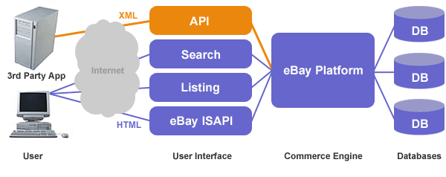
Methods
Data retrieval continued
eBay possesses a comprehensive API
However API only provides methods for accessing live auctions, completed auctions are outsourced to Terrapeak

Slide 6
Methods
Live auctions
Created a system that would monitor and record auction activity in real-time
Could only pull bidding data, eBay couldn’t push
Resulted in missed bids, inefficient
120829614046
IM 1
423812614446
IM 2
Search(“ipod nano”)
456197631246
IM 3
984829412551
IM 4
Listings (item id’s)
Item Monitors

Slide 7
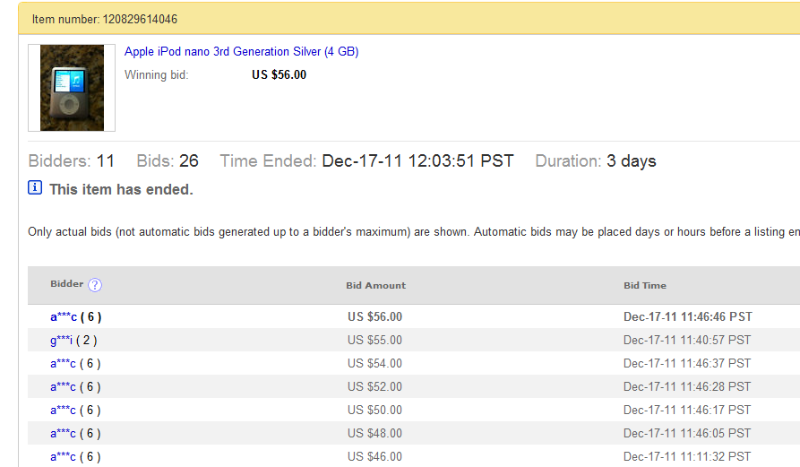
Methods
Finally settled on screen scraping
Beautiful Soup module for python
Able to scrape bidding information off of actual bidding summary web pages

Slide 8
Modeling
Retrieved bidding summaries for 200 ipod nano auctions
Filtered bidding by users (approx. 7 bidders per auction, 2 bids per bidder
(1-3 lowballers, 2-6 proxy bidders)
Formulated linear and polynomial equations relating a given user’s response to a prior bid

Slide 9
Modeling
Separated bidders into lowball bidders and proxy bidders based on bidding frequency
Lowball bidders constantly bidding in small increments above highest bid
Proxy bidders make educated bids 1-2 times per auction
Simulation: Randomly add lowballers and proxy bidders to the auction, each type randomly chooses an equation from their respective equation list

Slide 10
Results/Evaluation
Actual bidding patterns remain fairly similar across auctions with minimal standard deviation

Slide 11
Results/Evaluation
Simulated auctions followed a pattern similar to real-life auctions
Simulated average slope: 1.03511331
Actual average slope: 1.004505283
Tentative yes, agents can model human bidder behavior
Not perfect, however, doesn’t perfectly model proxy bidders nor does it take into account bid sniping

Slide 12
Future Work
Do bidders exercise the same behavior for other eBay categories?
For example are the behavior of bidders bidding on antiques different than auctions?

